Slide 1

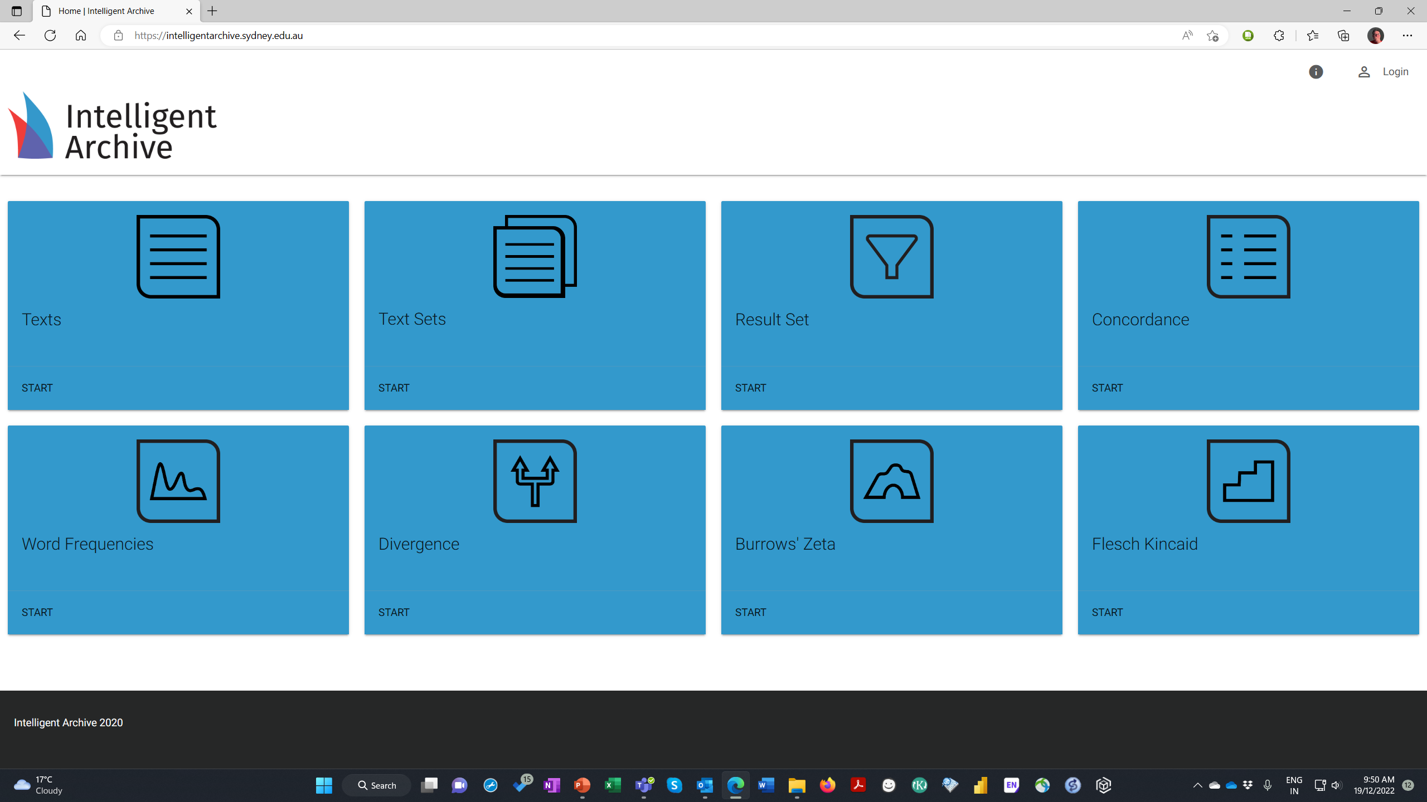
Intelligent Archive
Corpus Stylometry Framework
Project Goal:
The access and technical constraints attendant on images hosted in institutional repositories has proven an obstacle to effective collaboration on the scholarly analysis of images of significant cultural assets. The ubiquitous adoption of the International Image Interoperability Framework (IIIF) in emergent digital humanities projects in the GLAM sector presents the opportunity for seamless collaboration in the granular analysis and documentation of image components. IIIF frameworks, whilst open-source, require a back-end system and front-end development in order to be implemented. With Image Annotation Workbench, researchers can immediately apply semantic tags from discipline or research specific taxonomies on images stored across multiple institutional repositories and publish these annotations as research outputs. The project goal is to provide a generic infrastructure relevant to, and integrated with, HASS RDC program initiatives.
Approach:
The proposed project is to: develop the existing Image Annotation feature built for the READ Workbench platform as a standalone Image Annotation Workbench, add taxonomy configuration features and integrate platform access with the common HASS identity model. Subsequent development might include API access to Trove and Indigenous initiative repositories.
Benefit/Impact:
This initiative can deliver an immediate and tangible benefit by providing HASS researchers with a simple seamless workflow to annotate images without the requirement to engage developers. Researchers can initiate a collection, configure standard or custom taxonomies, outline regions and apply semantic tags and critical analysis as annotations. Researchers can contest and collaborate with other researchers both within and across disciplines and publish searchable, and individually addressable, annotations in an open-source standards-based format. Researchers can analyze institutionally heterogenous thematic collections and publish universally accessible results with zero technical skill.
Deliverables:
The deliverable from the project will be an open source Image Annotation Workbench platform running on ARDC server infrastructure with pilot collections of annotated images from Trove and/or Indigenous initiatives, method and process documentation, and skills transfer to ARDC.
Budget and Schedule:
Given the advanced state of development of the READ Workbench Image Annotation feature the total project cost (dependent upon integration requirementsThe project can be delivered within 4 months elapsed time. Systemik can provide:
research use cases,
demonstration of pilot implementation,
project proposal inclusive of requirements specification, development and implementation,
sustainability strategy for cost recovery of maintenance and support through research consulting services, and platform enhancement through project specific developments.
Infrastructure Outcomes:
Image Annotation Workbench is based on a mainstream open-source technology stack, a ‘research platform mapping’ methodology, and a workflow implementation pattern proven on a suite of research and commercial platforms (READ Workbench, Intelligent Archive, PerformX and Codifynd) developed by Systemik.
Copyright Systemik Solutions 2022

